Slide 1





University of Prince Mugrin
College of Computer & Cyber Sciences
Department of Artificial Intelligence
Resume Analysis: Information Extraction
AI312- Natural Language Processing
Team Members:
Rasha Ashawa | 4110496
Salwa Shamma | 4010405
Sana Shamma | 4010404
Nafisah Shams | 4010434
Instructor:
Dr. Syed Bukhari
Academic Year 2023 – 2024

Slide 2

Table of Contents
INTRODUCTION
PROBLEM
SOLUTION
METHODOLOGY
DATASET
MODEL TRAIN
MODEL TEST
CONCLUSION
Page 02

Slide 3


1. INTRODUCTION
Problem
Traditional approach to reviewing resumes and CVs:
large volume of job applications.
Is time-consuming.
Is costly.
Page 03

Slide 4
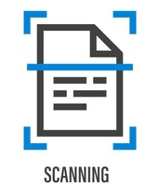
1. INTRODUCTION
Solution
Our solution is to develop a resume analysis system that utilizes the magic of NLP techniques, specifically Named Entity Recognition (NER), to extract and categorize resume data. This aims to speed up the recruitment process and free up HR personnel to focus on higher-value activities like interviews.
Page 04

Slide 5

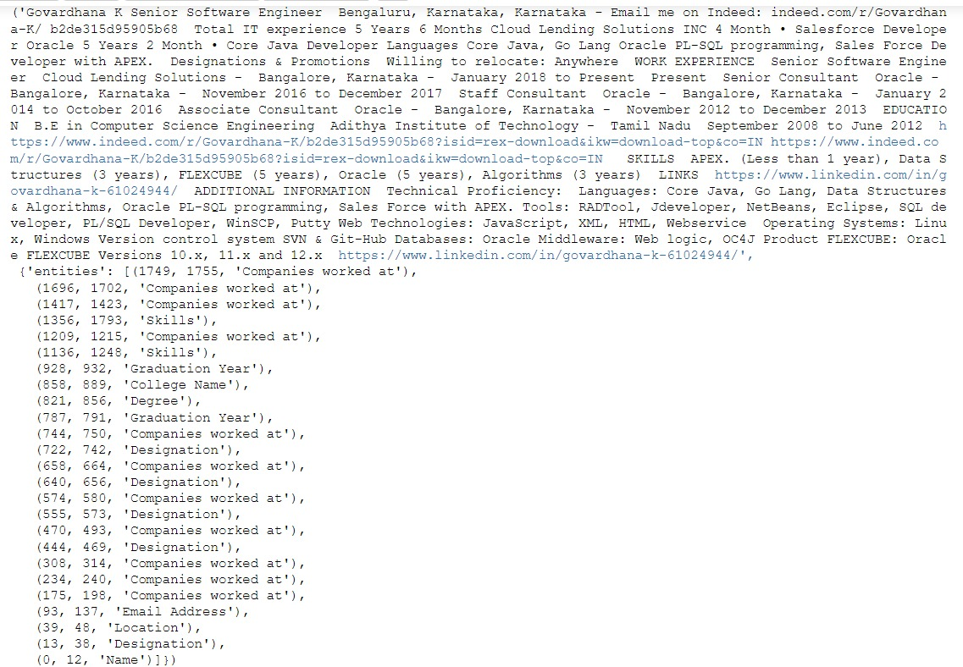

2. METHODOLOGY
Dataset Sample
Location
Index:39
Index:48
We have 200 samples, and our feature vectors have two tuples; the first tuple is full data, and the second tuple is the label The label is a dictionary in our case called entities; its values are an array whose elements are tuples. The second index of the tuple is the label for named entity recognition, the zero index is the location of the first characters of the value of named entity recognition, and the first index is the last location of the value of named entity recognition.
Data
Label
First Index
Entity Name
Last Index
Page 05

Slide 6
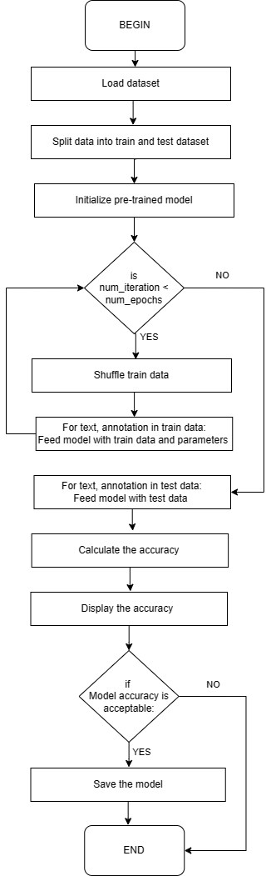

2. METHODOLOGY
Model Train
BEGIN
# Pre-Training Step
Load dataset
Split data into train dataset and test dataset
Initialize pre-trained model
# Train The Model
While num_iteration < num_epochs:
Shuffle train dataset
For text, annotations in train_data:
Feed model with train data and train parameters
# Test The Model
For text, annotations in test_data:
Feed model with test dataset
Calculate the accuracy
Display the accuracy
If model accuracy is acceptable:
Save the model
END
Step 1
Step 2
Step 3
Page 06

Slide 7
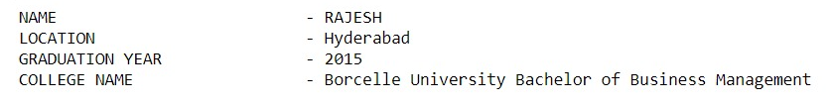


2. METHODOLOGY
System Output
Model Test
The system was tested on a dataset of 10 resumes, achieving an accuracy of 44% in correctly categorizing different sections of the resume. We achieved this result after training the model for 250 epochs on 190 training samples.
Input Sample
Name
College
Page 07

Slide 8
3. CONCLUSION
CONCLUSION & OUTLOOK
Train the model on a larger dataset with a wider range of information categories.
Integrate the model with RNNs to gain more context and better extract information,
01
02
Support the system with Arabic language resume as well.
Provide advice and suggest keywords that would make a CV more attractive and improve it
03
04
Page 08

Slide 9
BORCELLE
THANKS
FOR YOUR ATTENTION

